Slide 1
Final Project Demo
CAI-MING SYU

Slide 2
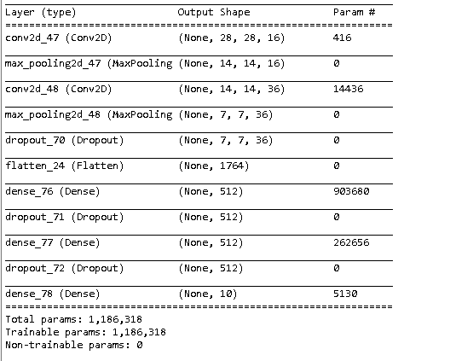
Modeling

Slide 3
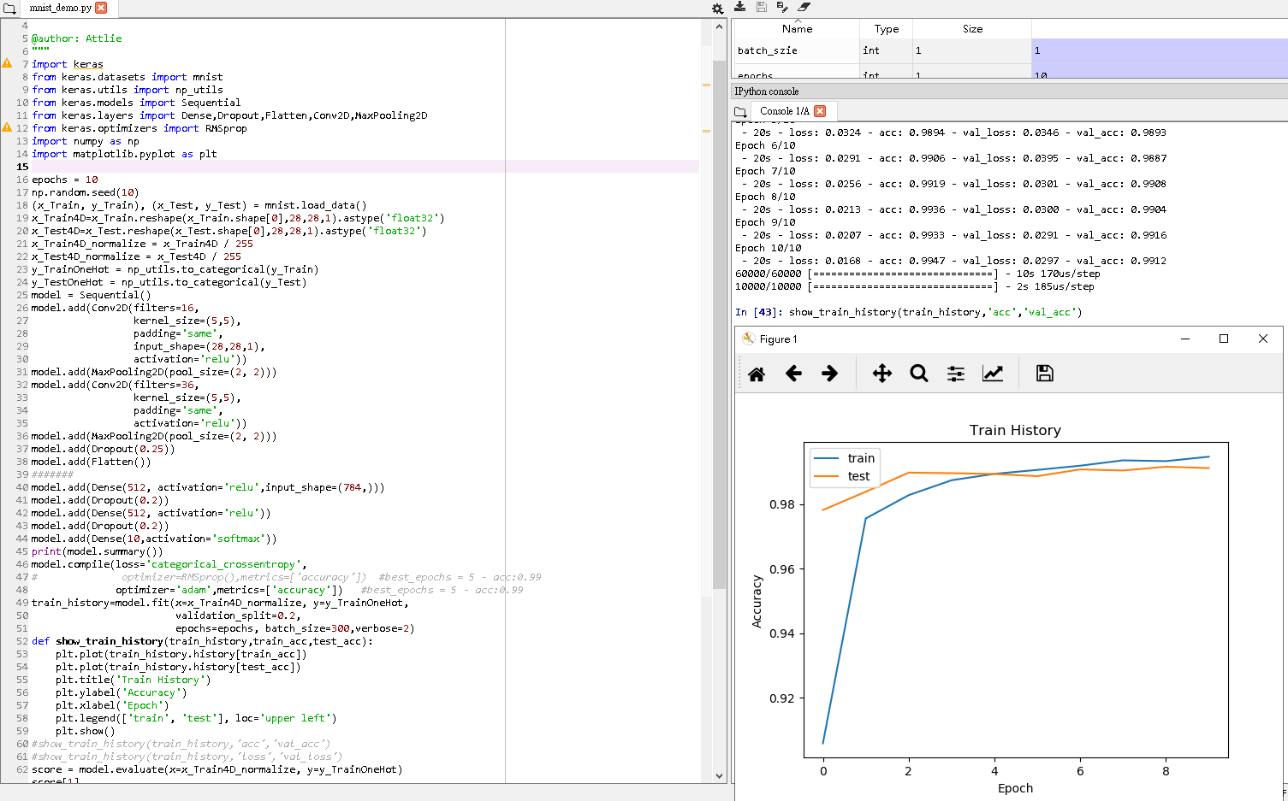
Create show_train_history to show the training process

Slide 4
Create show_train_history to show the training process
The results are as follows:
show_train_history(train_history, 'acc', 'val_acc')
If the accuracy of "acc training" has been improved, but the "accuracy rate of val_acc" has not increased, it may be the phenomenon of Overfitting (for more explanation, please refer to Bias, Variance, and Overfitting). After completing all (epoch) After the training period, test data will be used later to evaluate the accuracy of the model. This is another set of independent data, so the calculation accuracy will be more objective.

Slide 5
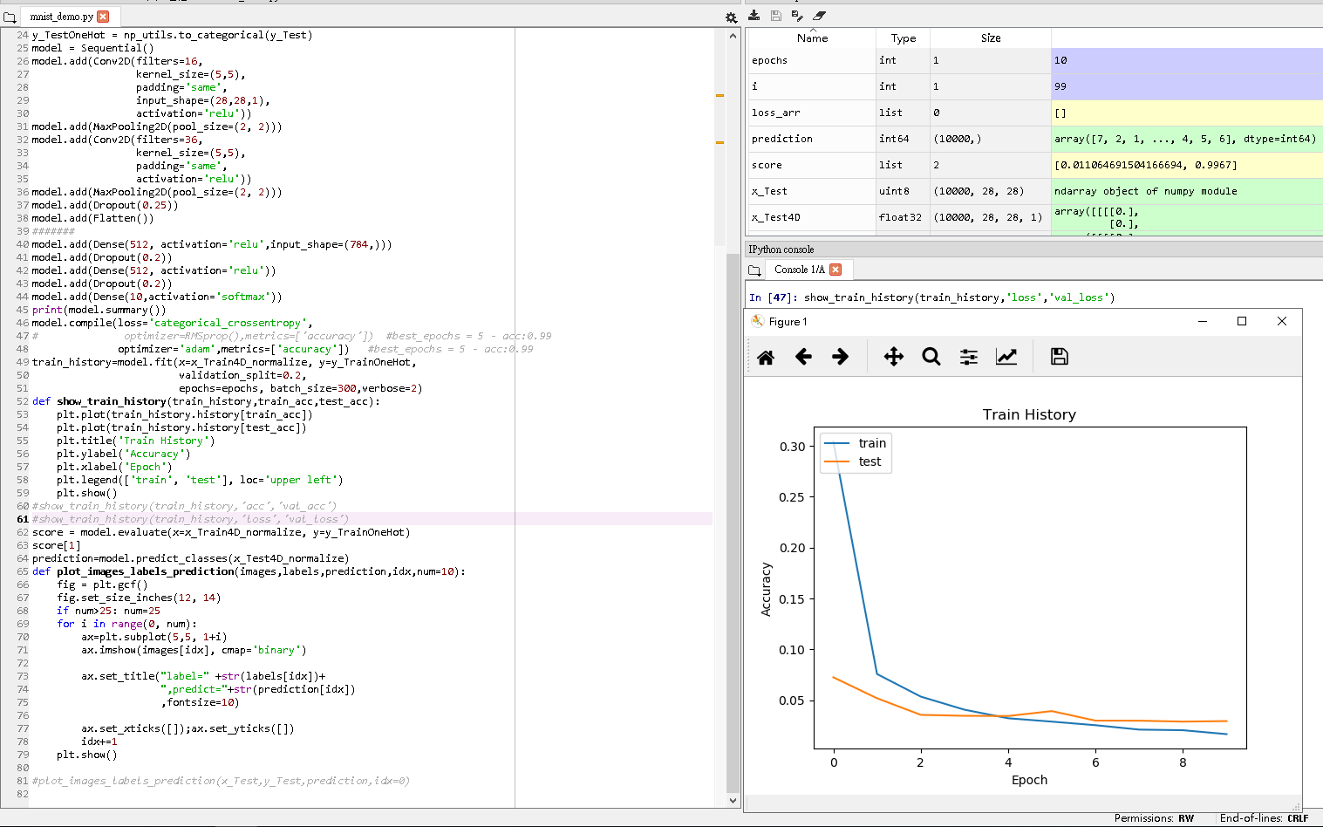
Create show_train_history to show the training process

Slide 6
Create show_train_history to show the training process
Then look at the execution result of the loss error:
show_train_history(train_history, 'loss', 'val_loss')
A total of 10 Epoch training cycles are performed and you can find:
No matter the training and verification, the error is getting lower and lower
In the late Epoch training, the "loss of loss training" is smaller than the error of "val_loss verification"

Slide 7
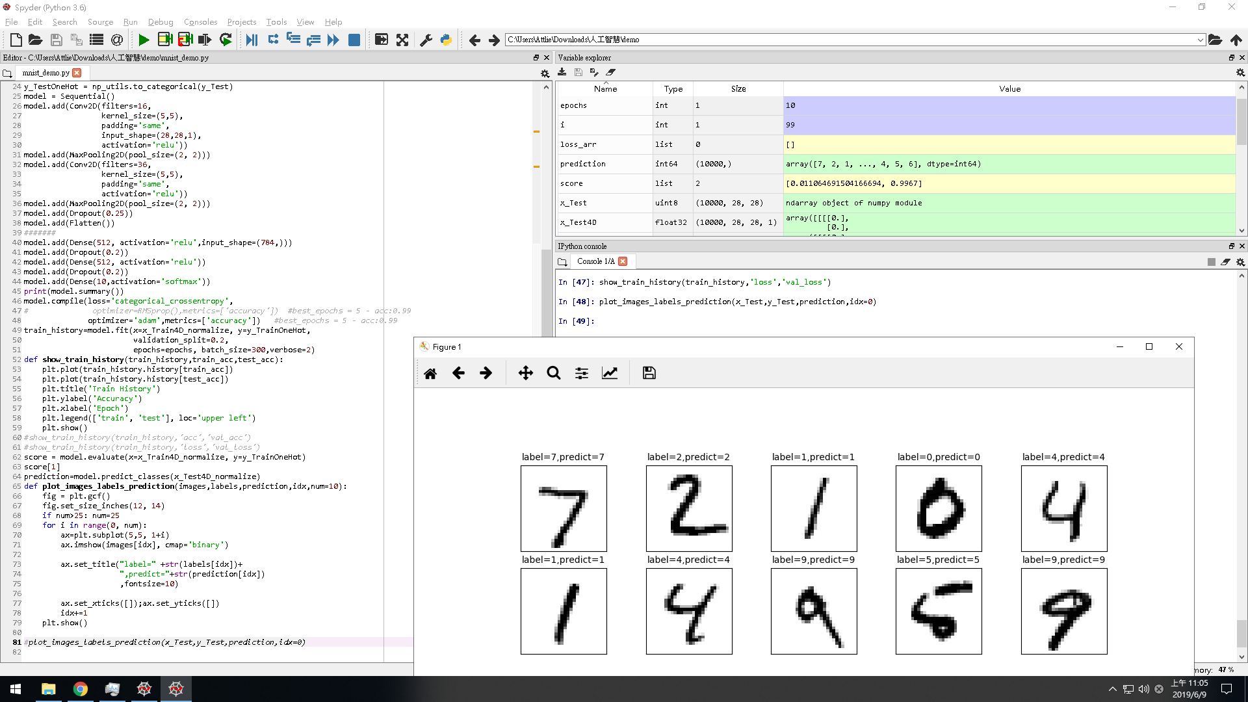
result

